Slide 1
Digital Services in the CRA
Updates - October 2019

Slide 2
Overview
Statistics Overview
My Business Account
My Account
Represent a Client
Represent a Client Beta

Slide 3
Statistics Overview
Digital Services Statistics
91%
17.1M
Returns filed electronically
(Includes T1, T2 and GST)
Returns were submitted through EFILE
9.2M
662K
Individuals registered for email notifications
Express NOAs issued for
2018 filing season
10M
637K
Individuals registered for My Account
Business accounts registered for email notifications
611K
1.2M
Representatives registered
for Represent a Client
Business owners registered
for My Business Account

Slide 4
My Business Account
Convenient
Easy
Fast
Secure

Slide 5
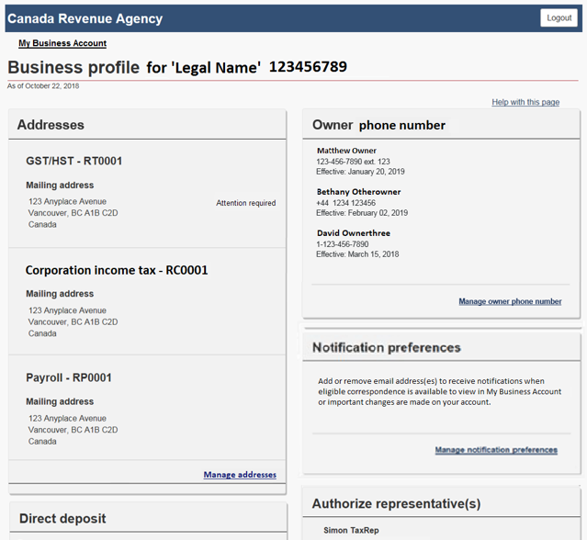
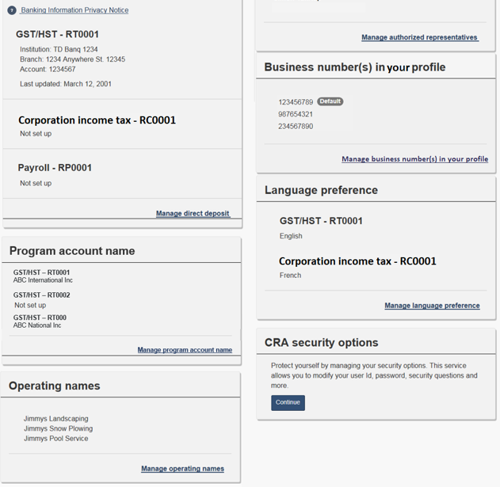
Fall 2019
My Business Account Business Profile

Slide 6
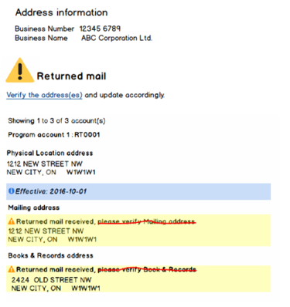
Fall 2019
Manage Return Mail Indicator

Slide 7
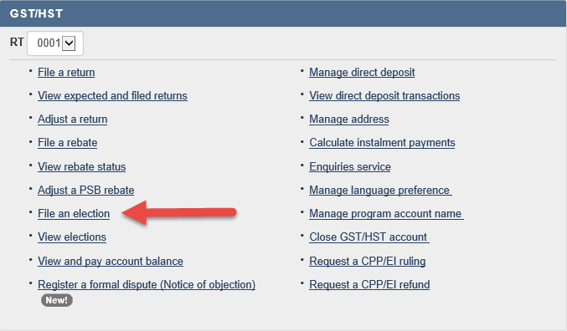
Fall 2019
File and View GST/HST elections

Slide 8
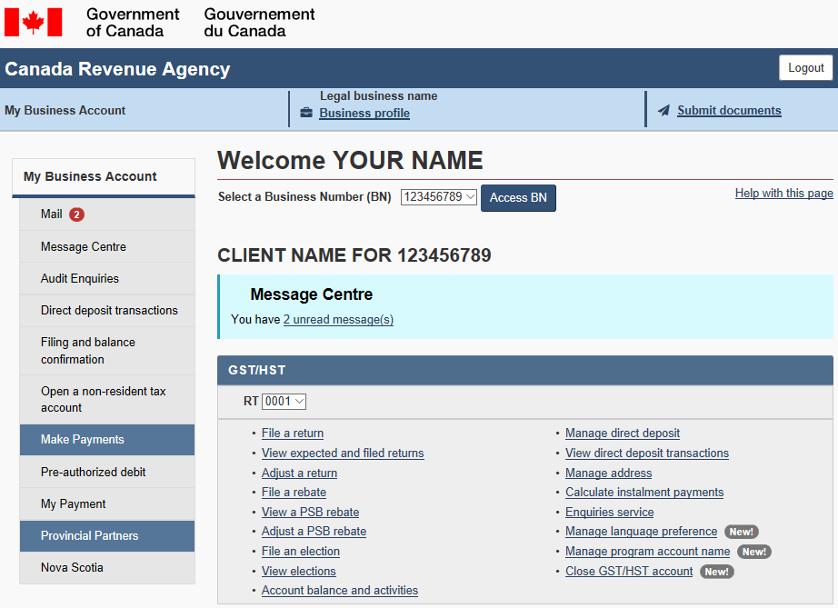
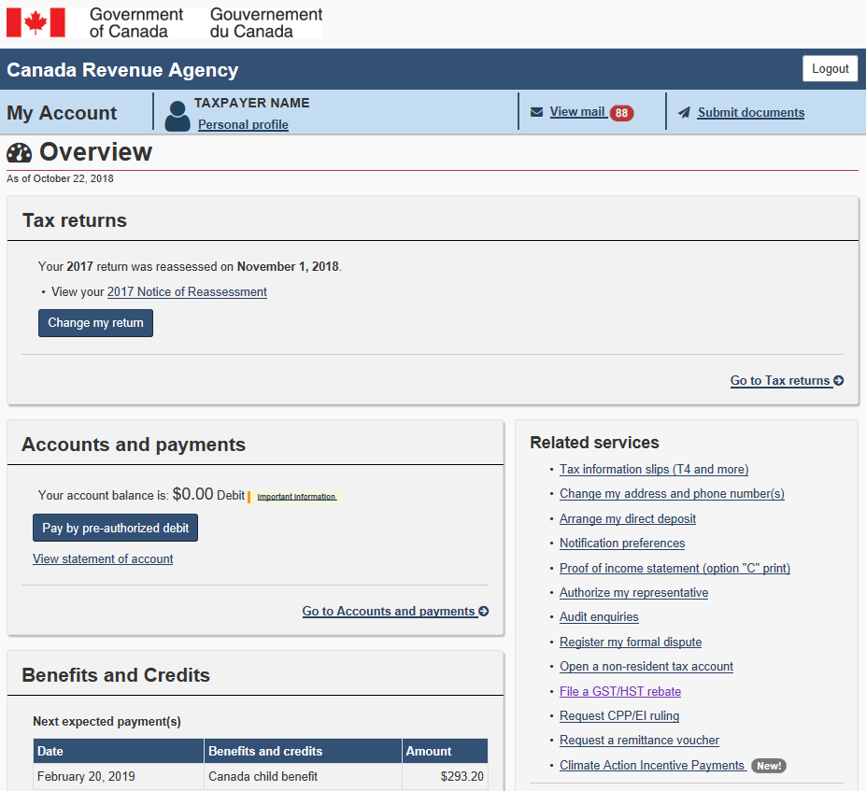
Fall 2019
File a GST189 – General Rebate application online
REBATE!

Slide 9
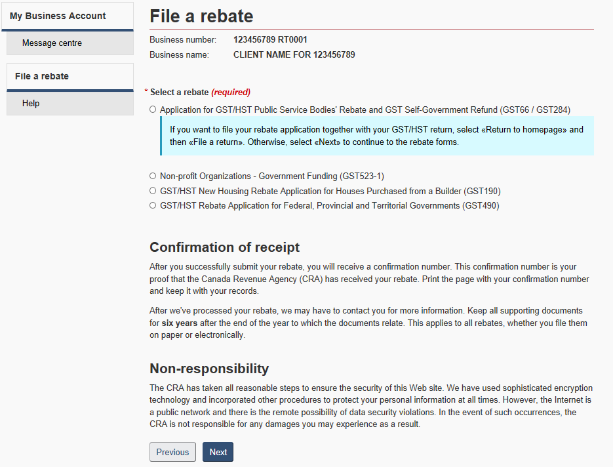
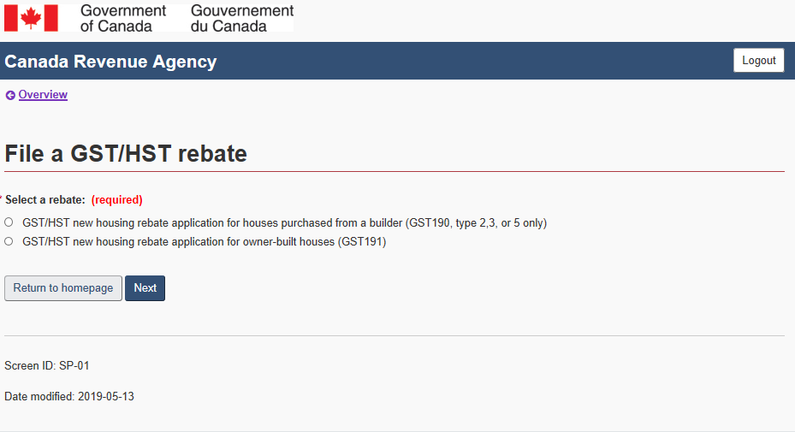
Fall 2019
File a GST189 – General Rebate application online
My Account view
My Business Account view

Slide 10
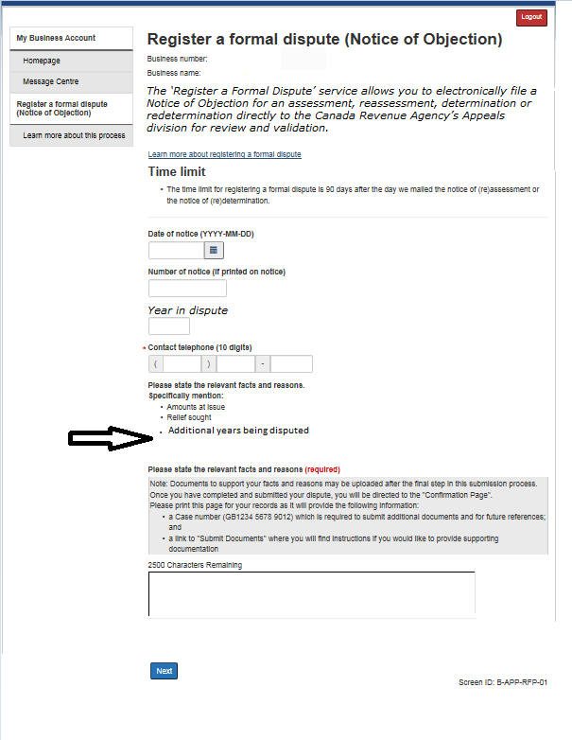
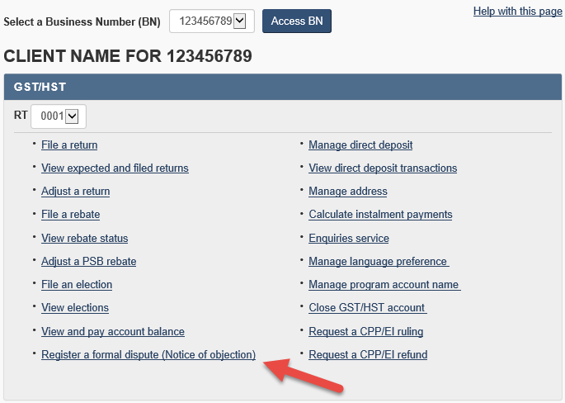
Fall 2019
GST/HST - Register a formal dispute MyBA
My Business Account
Electronic GST/HST
Notice of objection example

Slide 11
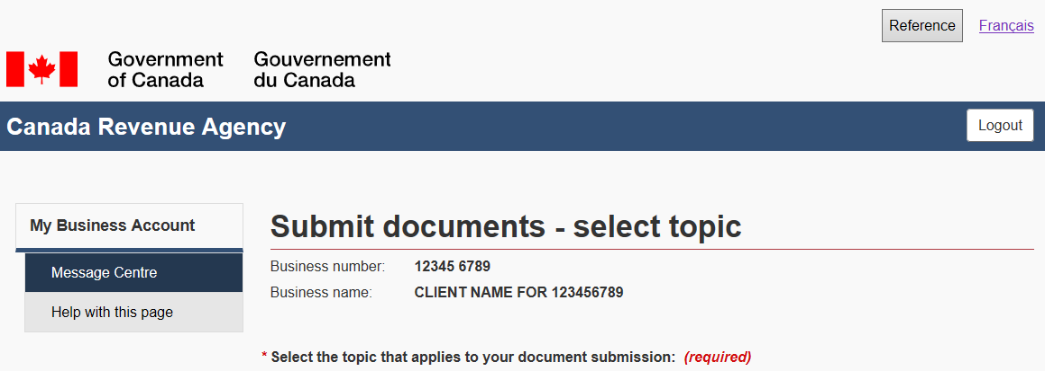
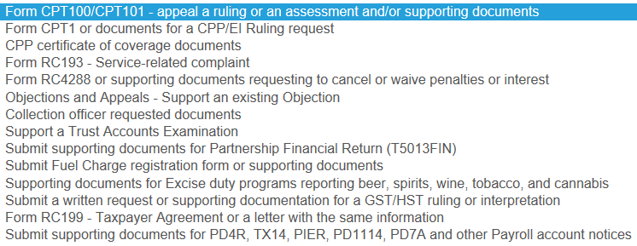
Fall 2019
Submit Documents - MyBA
1
2
3
1
2
3
1
2
3
1
2
3
Update example

Slide 12
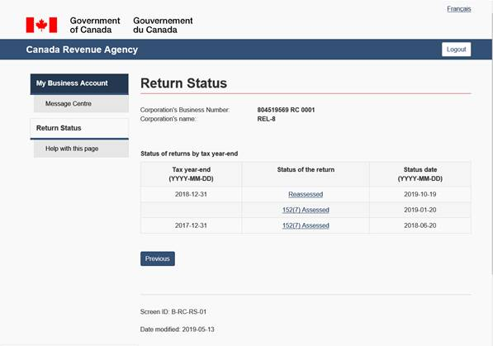
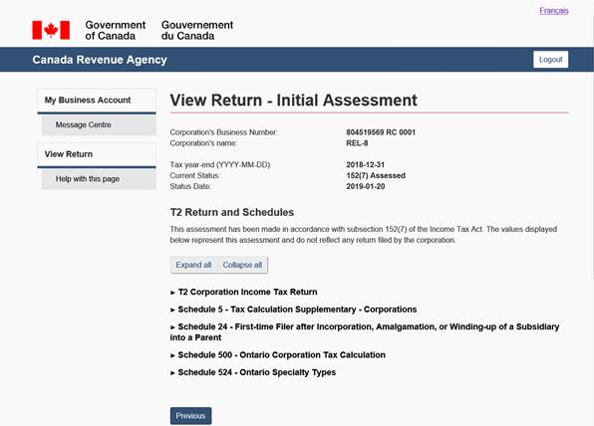
Fall 2019
T2 Return Status – 152(7) Assessment Indicator

Slide 13
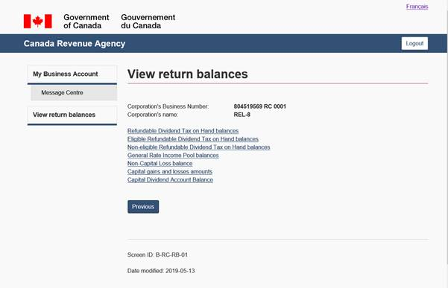
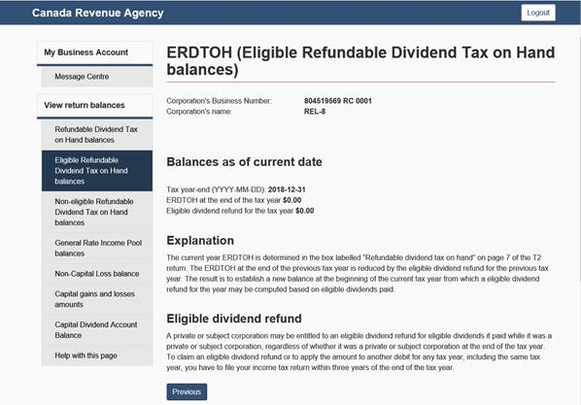
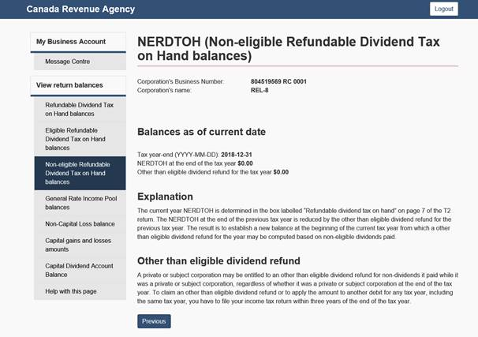
Fall 2019
T2 Return balance viewable in MyBA

Slide 14
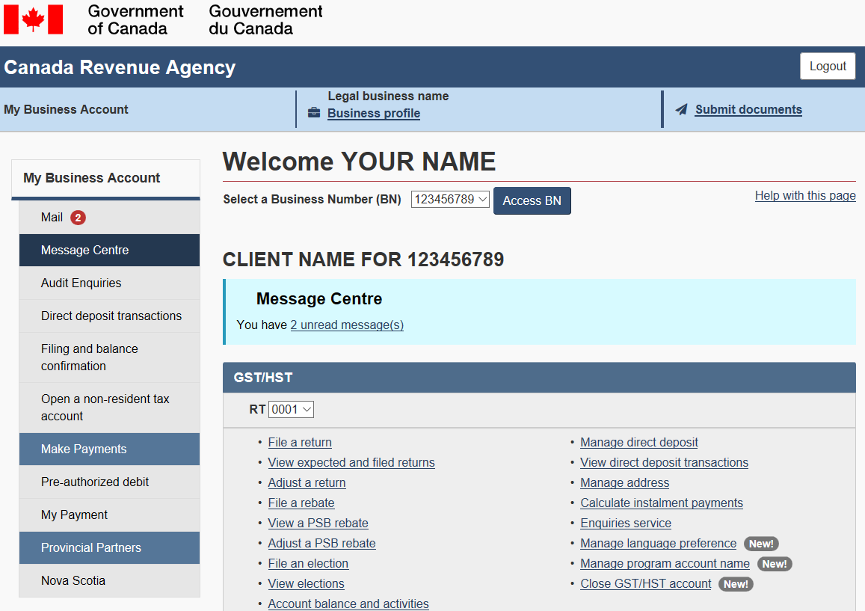
Fall 2019
Registered Charities on MyBA

Slide 15
Fall 2019
Email notifications – EFILE number
You have new mail from the Canada Revenue Agency for EFILE number(s): ^^EFILE Number^^
To view this mail, log in to Represent a Client and select "Access Mail."
This is an automated email message. Please do not reply.
You have unread mail from the Canada Revenue Agency, dated ^^Date of letter^^ for EFILE number(s): ^^EFILE Number^^
To View this mail, log in to Represent a Client and select "Access Mail."
This is an automated email message. Please do not reply

Slide 16
Fall 2019
Email notifications – Security info
Email notifications sent when updates are made to security information
Subject: Canada Revenue Agency - CRA password changed
Subject: Canada Revenue Agency - CRA user ID changed
Subject: Canada Revenue Agency - CRA security questions and/or answers changed
Dear Legal name:
Your CRA security questions and/or answers with the Canada Revenue Agency Login services was recently changed.
If you made this change please disregard this email.
If you did not make this change please call 1-800-959-8281.
If you're calling from outside Canada and the United States, call us collect at 613-940-8495.
The TTY (teletypewriter) number is 1-800-665-0354.
This is an automated email message. Please do not reply.

Slide 17
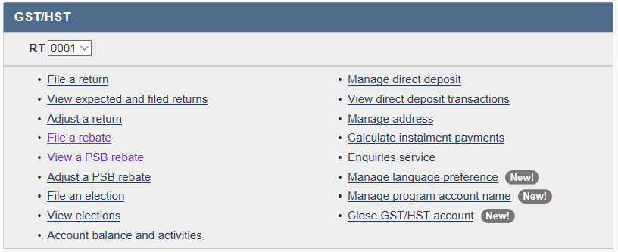
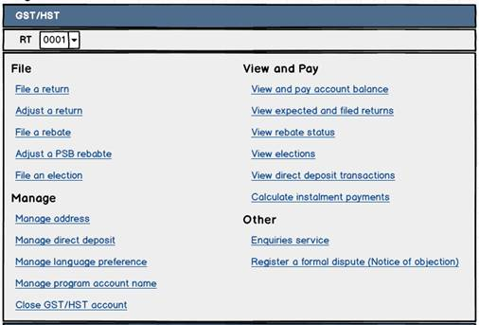
Future 2020
MyBA Re-grouping
Current
Future example

Slide 18
Future 2020
Other coming changes
Future 2020
Email notification:
Change to Authorized Representatives
Submit Docs Acknowledgement MyBA
File GST524 in My Account and MyBA
Capital Loss Balances viewable in MyBA

Slide 19
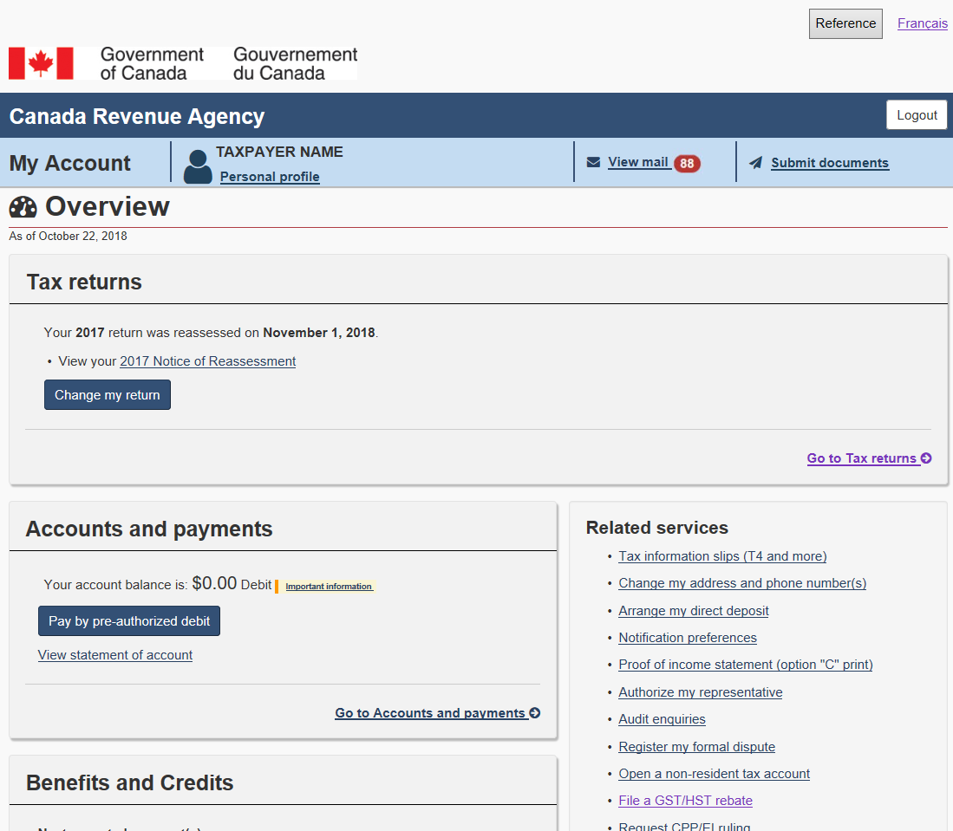
My Account updates
Convenient
Easy
Fast
Secure

Slide 20
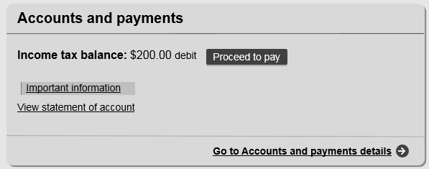
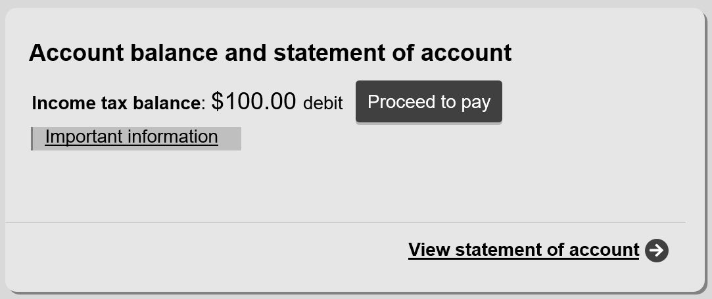
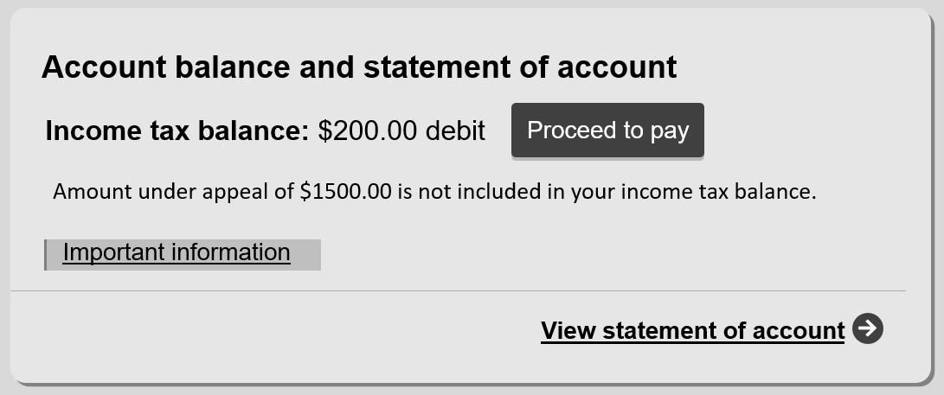
Fall 2019
Expanded pay options – MyA
Proceed to pay
Proceed to pay
Proceed to pay
Proceed to pay

Slide 21
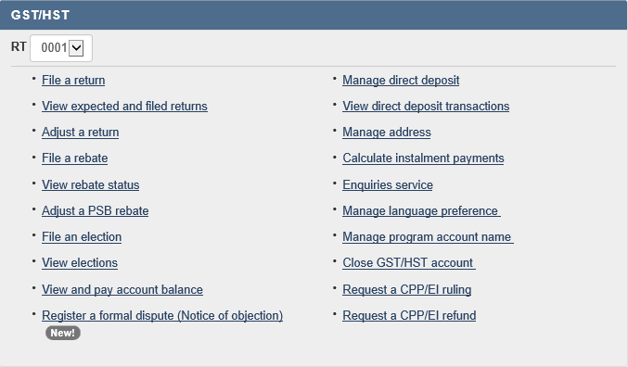
Fall 2019
View and pay account balance

Slide 22
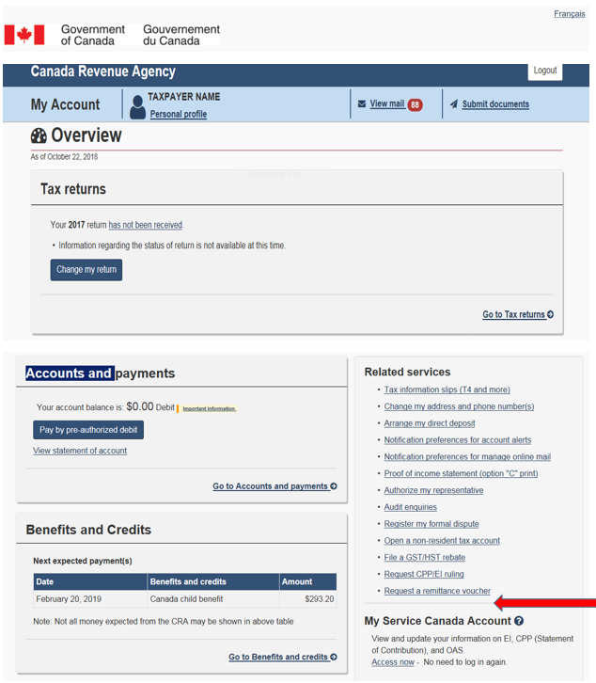
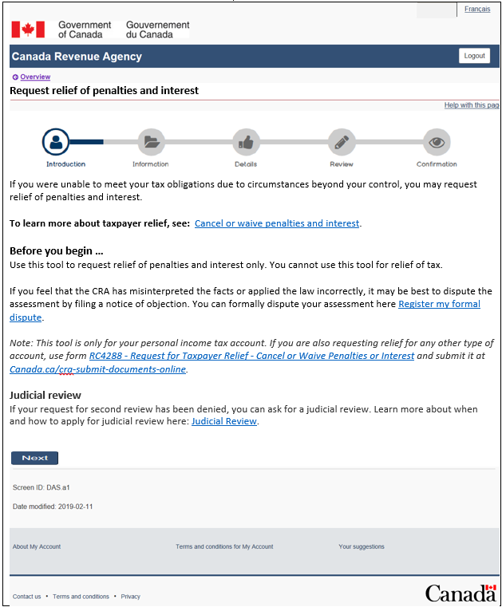
Fall 2019
Request for relief of penalties and interest – MyA

Slide 23
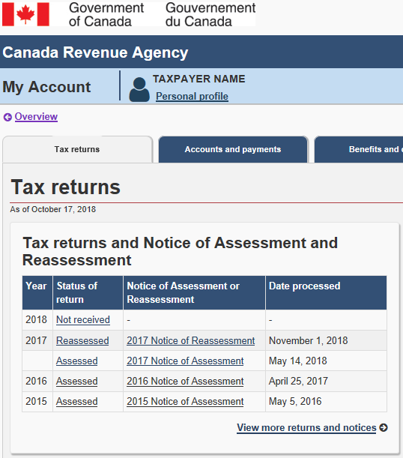
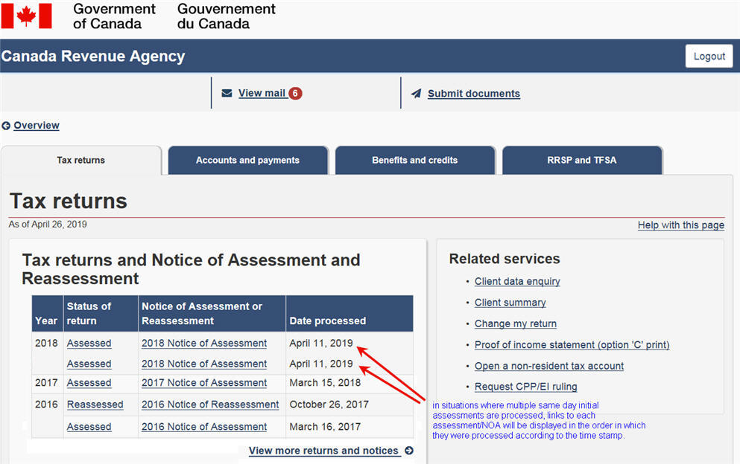
Future 2020
My Account & RAC –
Multiple Initial Assessments with Same Assessment Date
Current
Future
Multiple initial assessments

Slide 24
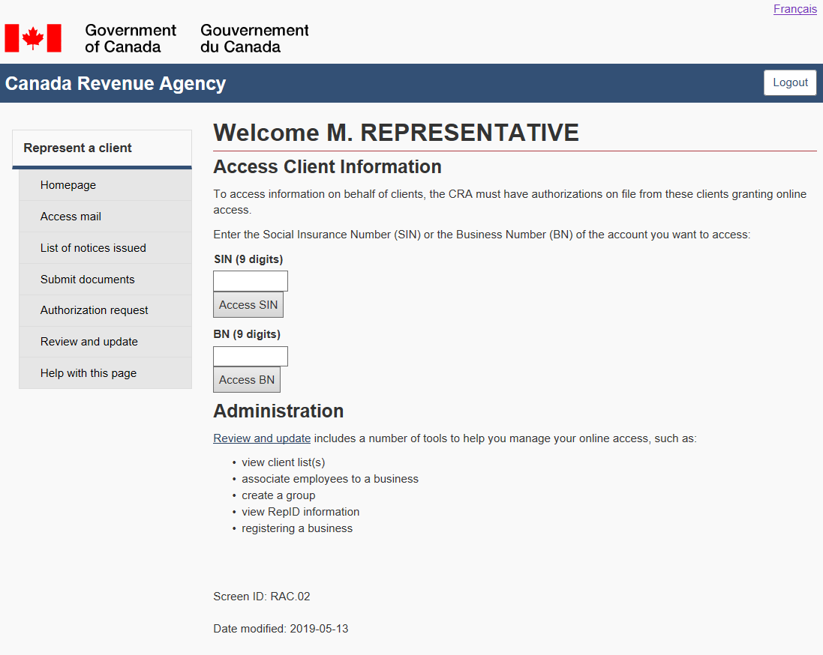
Represent a Client
Convenient
Easy
Fast
Secure

Slide 25
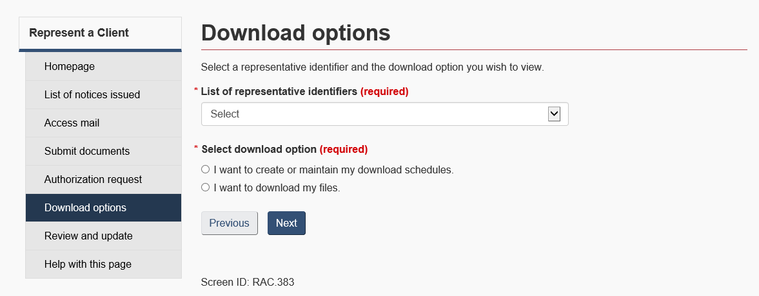
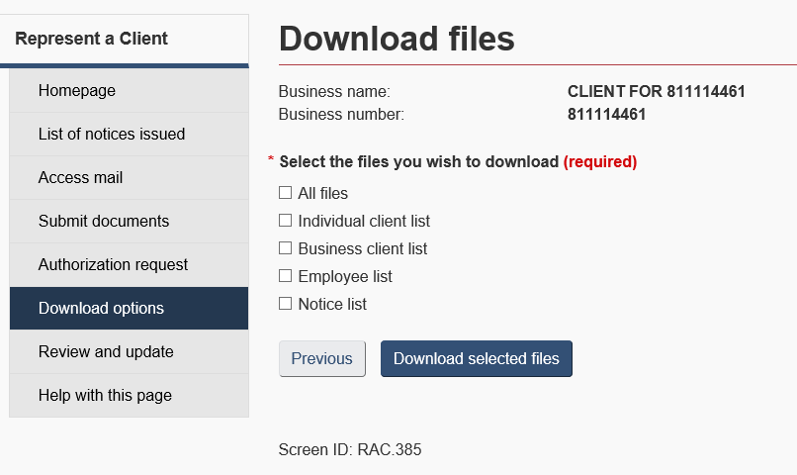
Fall 2019
Download Options - RAC
123xxx789
123xxx789
XXXX

Slide 26
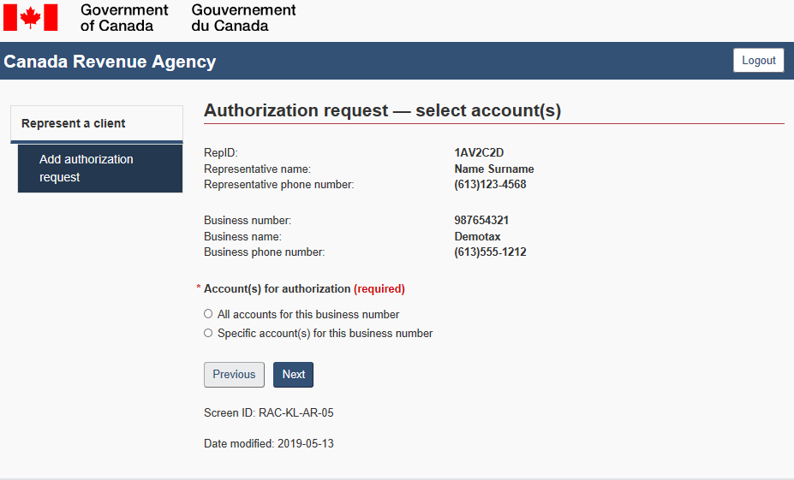
Fall 2019
Authorization overrides - RAC
(This authorization request will override any current authorization this representative has with this business.)

Slide 27
Future 2020
Other Updates to Authorization
Future 2020
1
New T1013, a combination of the T1013, RC59, and NR95
2
E-authorization process update for individuals in RAC
3
A new signature page for authorization for individuals using software
4
No authorization restrictions for Return mail or “Care of” indicators
5
Authorizations for individuals no longer cancelled upon a date of death

Slide 28
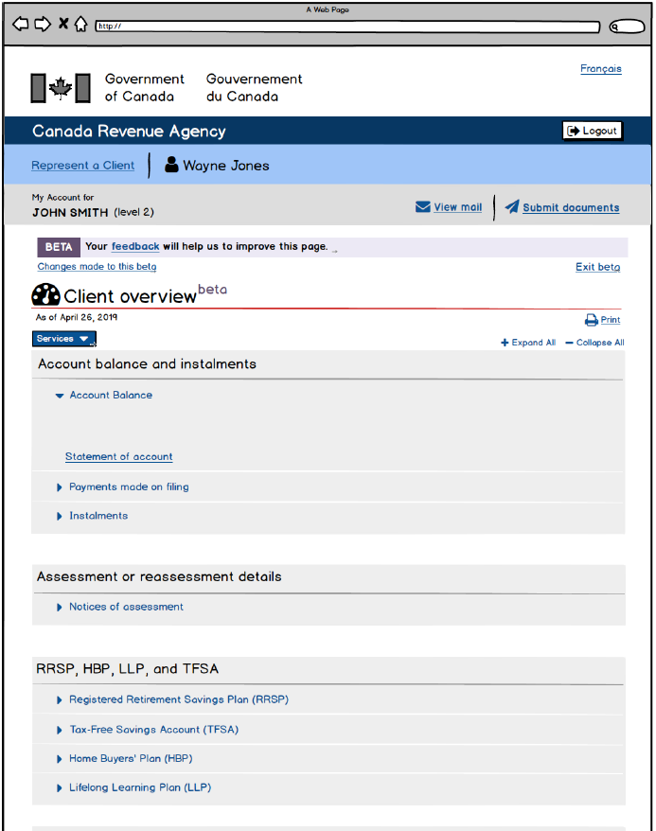
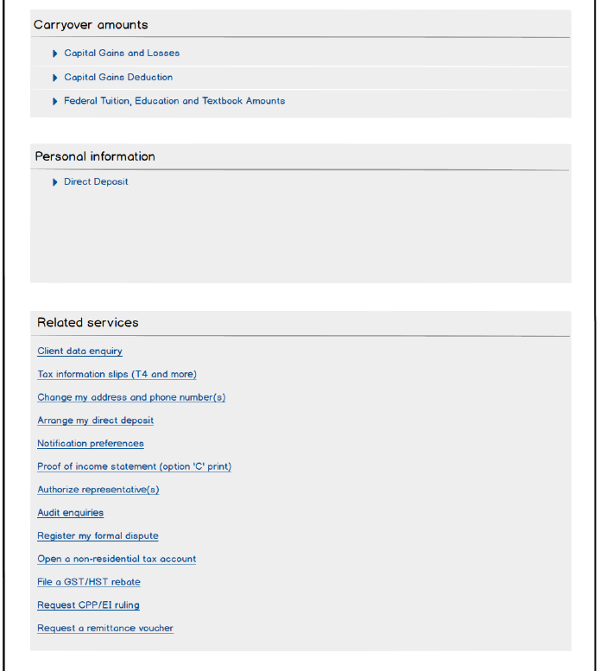
Update
Beta for RAC

Slide 29
Update
Beta for RAC
After the first 6 weeks:
Would be great if all the info (one section at a time) could be printable.
12,412 Participants
“Love it!!!, Quick and definitive”
595 Responses
Clear, but painful to flip between screens. Old way was better where you could see both screens.
5,671 Opt-outs
“I love the beta experience way better than the current one, I'm actually using the beta moving forward till it's finalized.”

Slide 30
The End

