Slide 1
2020 Canadian Finance Study and the Canadian Experience November 5, 2020

Slide 2
Today’s Agenda
About the 2020 CPA Canada Canadian Finance Study
The impact of COVID-19
Findings – current attitudes, trend data
Future directions
Copyright © 2021 Chartered Professional Accountants of Canada

Slide 3
2020 CPA Canada Canadian Finance Study
About the study:
Web based survey conducted by Nielsen of over 2000 Canadians reflecting demographic of adult population
Explore financial knowledge, habits, attitudes and confidence on a comprehensive range of topics
Trend data, every two years
2020 different: Impact of COVID-19 pandemic
What’s different about our 2020 study:
Field testing conducted September 4th – September 16th, 2020.
Survey is taken six months into a pandemic and cases are increasing
Explored standard questions, for trend purposes, and added COVID specific questions that would allow us to
Explore immediate impacts of COVID on jobs and income
Look at some of our trend data through the lens of COVID impact
Copyright © 2021 Chartered Professional Accountants of Canada

Slide 4
The impact of COVID-19

Slide 5
The Canadian COVID Experience
Sept 2020
Schools reopen in various combinations of virtual and in-class learning; Hotspots begin to emerge, and by month end 2nd wave
May 2020
Seasonal businesses, stores with curbside pickup begin to open
Jan 2020
First confirmed case
01
02
03
04
05
06
March – April 2020
State of emergency, businesses and schools closed down across the country, Parliament shuts down for five weeks, border closed to all non-essential travel. By the end of April 3 million
Jun – Aug 2020
Case numbers low, businesses reopened under social distancing restrictions
October 2020 – now
Case numbers surpass the first wave, restrictions begin to be reapplied in hot spots
Copyright © 2021 Chartered Professional Accountants of Canada

Slide 6
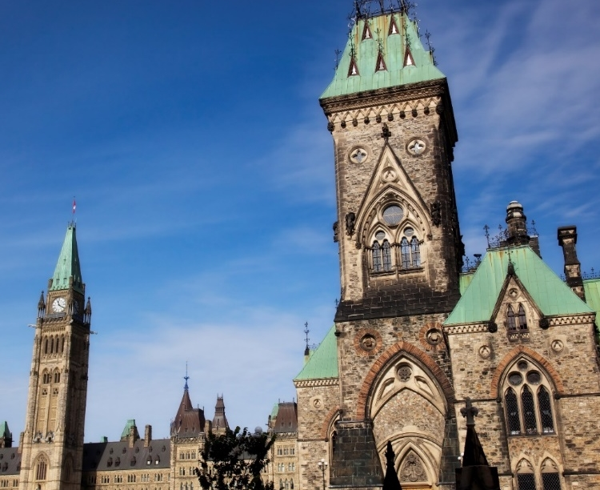
Government Supports
Mar. – June: $Bs in support for businesses, individual workers, students, and for specific groups including seniors, disabled and Indigenous Communities, as well as certain enhanced benefits like childcare benefits
Key personal supports
Canadian Emergency Response Benefit (CERB): $2,000 per month, taxable, for those who lost jobs due to COVID the program ended on Sept 27th, replaced with simplified Employment Insurance Benefits, comprised of the Canada Recovery Benefit (CRB), Canada Recovery Sickness Benefit (CRSB), and Canada Recovery Caregiving Benefit (CRCB)
Canadian Emergency Student Benefit (CESB) $1,250 per 4-week period May to Sept. ($2,000 if student has dependents or disability)
Copyright © 2021 Chartered Professional Accountants of Canada

Slide 7
33% say their stress level regarding money matters has increased due to COVID19
We saw a significant impact on stress people about money management.
Copyright © 2021 Chartered Professional Accountants of Canada

Slide 8
Job Loss or Reduction in Hours
31% of our respondents experienced job loss or reduction in hours; half of these workers were under 35.
Workers under 35 were 3 times more likely to experience either a temporary job loss or reduction in hours as compared to workers 55 years of age and older.
Copyright © 2021 Chartered Professional Accountants of Canada

Slide 9
22% of Respondents Received a Federal COVID-19 related Employment Benefit
Copyright © 2021 Chartered Professional Accountants of Canada

Slide 10
% Receiving Federal COVID-19 Benefits by Region and Age
Benefits by Region
The proportion of people receiving benefits by region ranged between 19% - 26%, with the largest percentage in Alberta.
AB
26%
Age
Respondents under the age of 35 were more than 2 times more likely to have reported receiving a benefit as compared to respondents over the age of 55.
BC & Territories
22%
ON
23%
QC
19%
Man/Sask
23%
Atlantic
19%
Copyright © 2021 Chartered Professional Accountants of Canada

Slide 11
Income has Declined for 31% of Respondents
Respondents under the age of 35 (41%) were more likely to report that their incomes had decreased as a result of the pandemic, as compared to respondents 55 years and older (25%).
Respondents under the age of 35 were also significantly less likely than those over 55 to report that their incomes were not impacted as a result of the pandemic 55 years and older.
Copyright © 2021 Chartered Professional Accountants of Canada

Slide 12
26% say their financial situation is worse than a year ago.
26% of respondents reported that they were more worse off financially in 2020 compared to 15% in 2018, an increase of 60%.
26% of respondents said they were better off financially in 2020 compared to 36% in 2018, an increase of 38%.
Alberta had the highest proportion of respondents that indicated that their financial situations had worsened compared to the prior year
Copyright © 2021 Chartered Professional Accountants of Canada

Slide 13
Impact of COVID on spending and saving
Respondents under the age of 55 were most likely to report that their savings decreased significantly as a result of the pandemic
Respondents under the age of 35 were most likely to report that the amount of their savings decreased as a result of the pandemic
Respondents 55 years and older were most likely to report that their savings were not affected by the pandemic.
Copyright © 2021 Chartered Professional Accountants of Canada

Slide 14
21% of pre-retired respondents expect to delay retirement
Women (51%) were more likely to respond that they plan to work past the age of 65 because they do not believe they can afford to retire as compared to men (35%)
49% of respondents over the age of 55 indicated that they plan to work past the age of 65 because they enjoy their jobs.
Men (24%) were more likely to indicate that they plan to retire later as a result of the pandemic as compared to women (17%).
Copyright © 2021 Chartered Professional Accountants of Canada

Slide 15
2020 snapshot of financial attitudes, habits, capability and confidence
Copyright © 2021 Chartered Professional Accountants of Canada

Slide 16
Greatest Sources of Financial Stress
72% of Canadians reported financial stress …
Men and Women were equally likely to report being stressed about finances.
Big three stresses are saving, debt repayment, and retirement planning.
Almost one in 10 is stressed about affording the basics
Most stressful element | 2020
Saving money | 16%
Paying off my debts/Paying off partner’s debts | 11%
Saving/planning for retirement | 11%
Making sure I can afford the necessities | 9%
Investing | 7%
Home ownership | 7%
Remembering to pay all of my bills on time | 4%
Continuing to support an adult child | 2%
Affordable childcare | 1%
Keeping up with peers | 1%
Helping to support aging parents | 1%
Costs of having a baby | 1%
Being able to afford programs for my kids | 0%
Other | 2%
Not applicable – I am not stressed from managing my money | 28%
Copyright © 2021 Chartered Professional Accountants of Canada

Slide 17
Confidence in knowledge and skills: Comparing to 2018
 | 2020 | 2018
Confidence decreased compared to 2018
Saving for children’s post-secondary education | 67% | 74%
Teaching children about money | 76% | 82%
Advising an aging parent | 51% | 51%
Saving for an emergency | 70% | N/a
We also saw marked slippage in teaching children about money and saving for post secondary education. We also saw the following changes:
Respondents under the age of 35 were least confident about saving for an emergency
Our survey indicated that people were less confident when it came to saving for post-secondary education and teaching children about money.
Women were less confident than men in advising their aging parents on money matters.
Copyright © 2021 Chartered Professional Accountants of Canada

Slide 18
Whether Stick to a Household Budget
Explored the financial habits Canadians are developing, and how they are practicing good financial decision making.
Almost half of respondents have a household budget – vast majority – 86% -- always or usually stick to it. Only 3% rarely or never do.
Both men and women were equally as likely to stick to a household budget
Respondents 55 years of age and older almost always responded that they always or usually stick to a budget
Copyright © 2021 Chartered Professional Accountants of Canada

Slide 19
Savings in the Last Five Years
In the past five years, almost half (43 per cent) of the respondents have modified their investment strategy and 60 per cent of the participants who are working have put money aside for their retirement.
Respondents over the age of 35 were more likely to respond that they had put aside retirement savings in the past 5 years
Based on the responses, males were more likely than females to have modified their investment strategy in the past 5 years
Copyright © 2021 Chartered Professional Accountants of Canada

Slide 20
Types of Investments or Accounts
Consistent with our findings in 2018.
Respondents 55 years and older were twice as likely to own individual stocks and mutual funds as compared to respondents under 35 years old.
Men (37%) were more likely to own individual stocks as compared to women (22%).
Copyright © 2021 Chartered Professional Accountants of Canada

Slide 21
Concerns About the Future and Debt
Canadians have expressed they have significant concerns and reservations about the future.
In all these categories, Canadians under 35 reported being the most concerned about their financial future and managing debt.
Consistent with 2018
Copyright © 2021 Chartered Professional Accountants of Canada

Slide 22
Preparing for the road ahead
Copyright © 2021 Chartered Professional Accountants of Canada

Slide 23
Resources
To access the 2020 Canadian Finance Study, please visit: cpacanada.ca/canadianfinancestudy2020
To access CPA Canada financial literacy resources, visit: cpacanada.ca/financialliteracy.
Road Ahead Webinar Series, visit: cpacanada.ca/en/the-cpa-profession/financial-literacy/financial-literacy-resources/wellness-during-crisis-webinars
Tax After Turbulent Times
Life Insurance after COVID-19: Protecting yourself now and in the future
Wellness in a Time of Crisis
Coping with Stress
Copyright © 2021 Chartered Professional Accountants of Canada

Slide 24
Thank You financialliteracy@cpacanada.ca

